Slide 1
Traffic Accidents Analysis
Made By
Sherif Basem
Abd-Alaziz Alsayed
Mostafa Mahmoud
Mohamed Hossam

Slide 2
Table of contents
Introduction
Overview of data
Data Preprocessing
Analysis
Visualization
Website
Conclusion

Slide 3
Introduction
Traffic accidents are a pressing global issue, impacting public health, safety, and the economy. Each year, millions of accidents occur, leading to injuries, fatalities, and property damage. Identifying accident patterns and contributing factors is essential for policymakers, urban planners, and engineers to improve traffic systems and enhance road safety.
In this project, we analyze traffic accident data to uncover insights regarding accident frequency, and factors such as weather, time of day, and road conditions. The goal is to leverage data analysis and visualizations to identify trends, helping inform interventions to reduce accident rates and improve safety measures.

Slide 4
Overview of Data
Data Source: the dataset source is the gov.uk site https://data.gov.uk/dataset/road-traffic-accidents
Data Parameters:
Reference Number,
Grid Ref: Easting, Northing,
Number of Vehicles, Casualties
Accident Date, Time (24hr)
Road Class, Road Surface
Lighting Conditions, Weather Conditions
Casualty Class, Casualty Severity, Sex of Casualty, Age of Casualty
Type of Vehicle

Slide 5

Data Processing
The data was initially stored in an Excel file we loaded it to sqlserver to prepare a table for the analysis then used python for transformation and The transformed data was then exported as a CSV file for analysis and visualization purposes.

Slide 6
Analysis
We conducted the following analyses:
Accident frequency by location
Correlation between weather and accident rates
Effect of lighting and road conditions on accident severity
Distribution of accidents over time (day/night, weekdays/weekends)
Casualty demographics and vehicle types

Slide 7
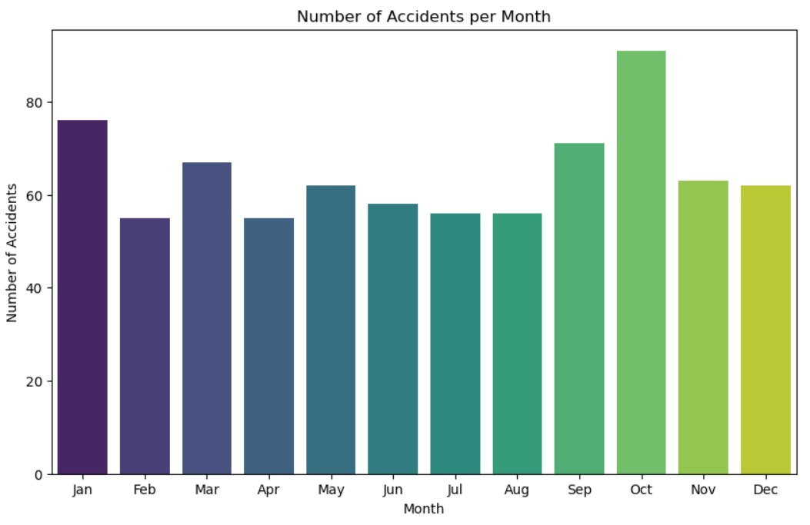
Visualization
The visualizations helped us identify significant patterns:

Slide 8
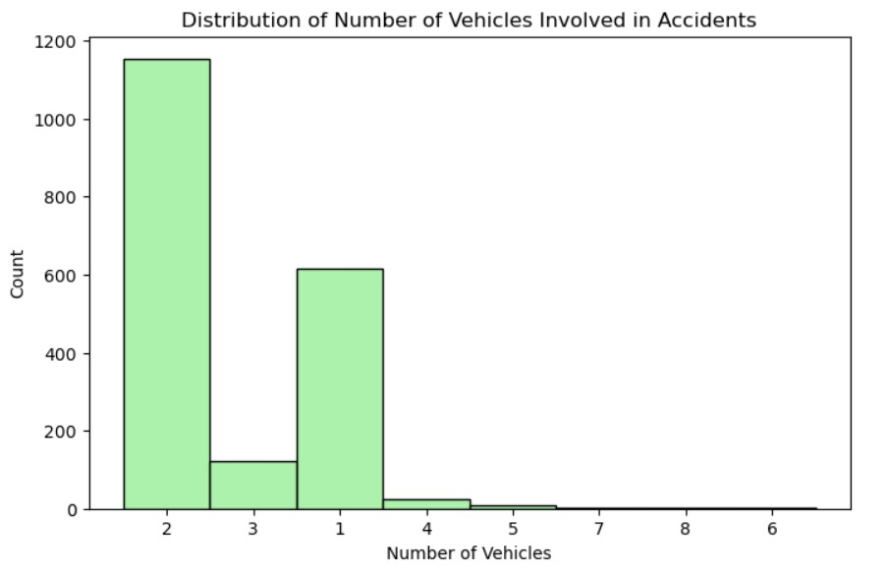
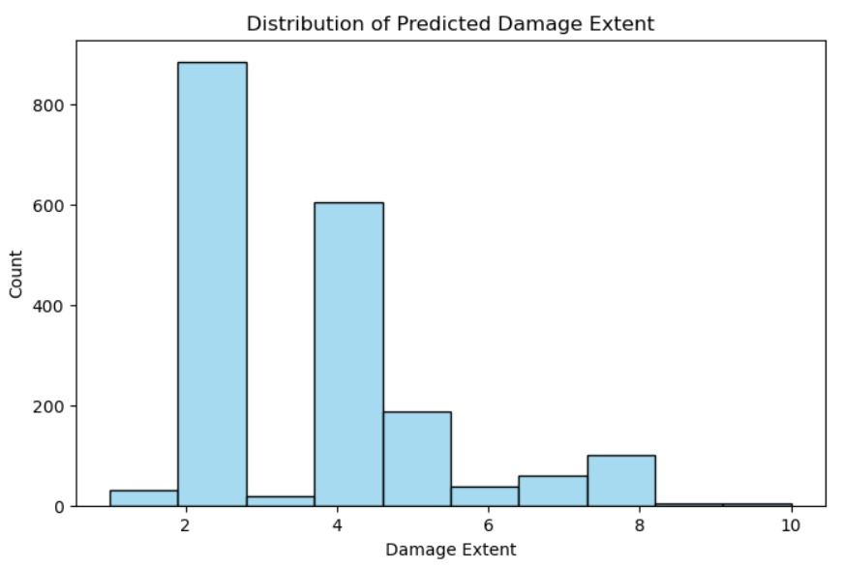
Visualization

Slide 9
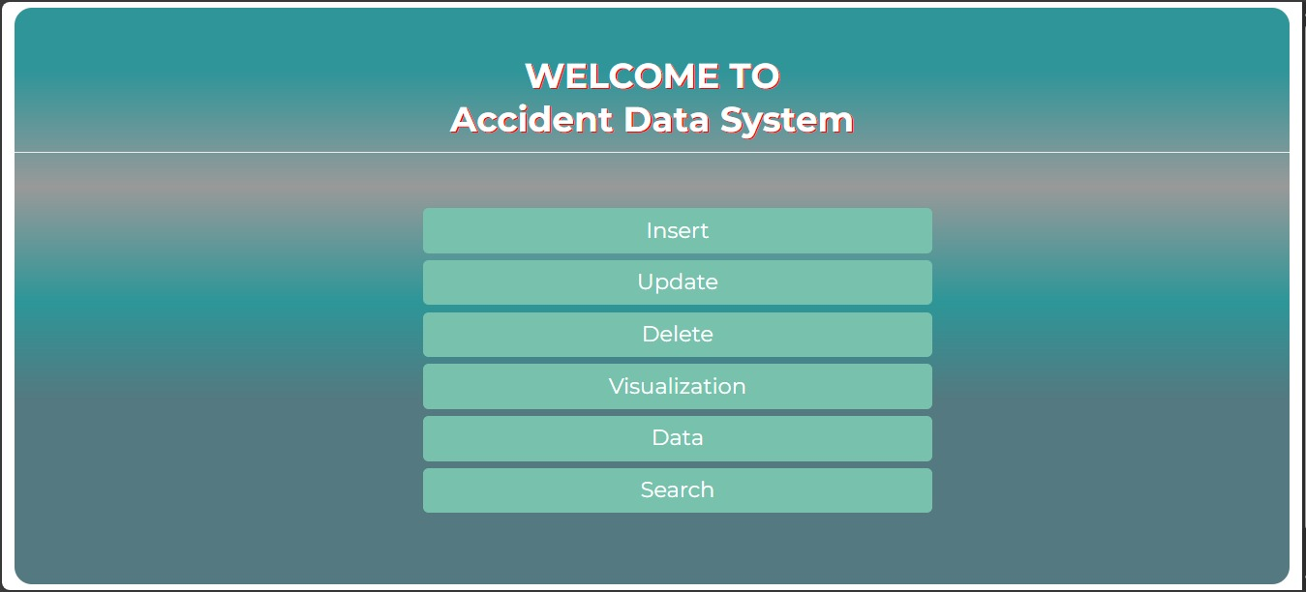
Website
A website where we can insert, delete update, and alter data and show visualization

Slide 10
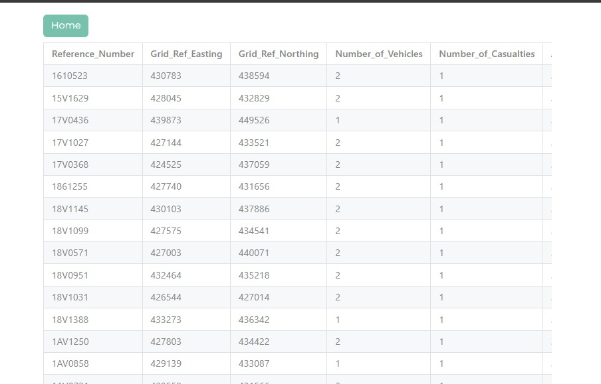
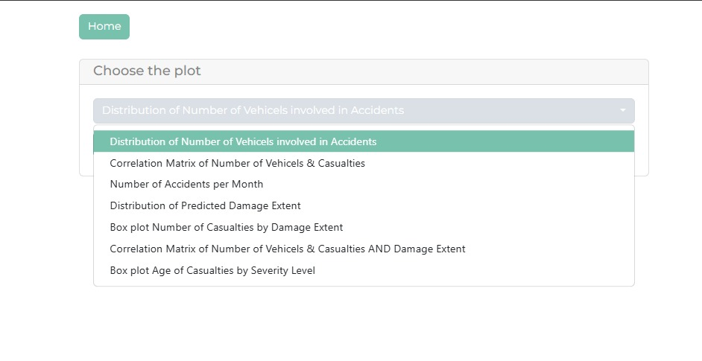
Website

Slide 11
Conclusion
The analysis reveals that weather conditions, lighting, and road surface significantly impact traffic accident frequency and severity.
Policymakers and road safety engineers should focus on enhancing road conditions and ensuring proper lighting in accident-prone areas. Additionally, introducing better traffic management systems and raising public awareness during adverse weather conditions can potentially reduce accident rates. By implementing data-driven strategies, we can mitigate future risks and enhance overall road safety.

